Slide 1
Chapter 06 Normalization of Database Tables

Slide 2
Chapter 6
Normalization of Database Tables

Slide 3
Learning Objectives
In this chapter, you will learn:
What normalization is and what role it plays in the database design process
About the normal forms 1NF, 2NF, 3NF, BCNF, and 4NF
How normal forms can be transformed from lower normal forms to higher normal forms
That normalization and ER modeling are used concurrently to produce a good database design
That some situations require denormalization to generate information efficiently

Slide 4
Boyce-Codd Normal Form (BCNF)
A table is in Boyce-Codd normal form (BCNF) if every determinant in the table is a candidate key.
(A determinant is any attribute whose value determines other values with a row.)
If a table contains only one candidate key, the 3NF and the BCNF are equivalent.
BCNF is a special case of 3NF.
Figure 5.7 illustrates a table that is in 3NF but not in BCNF.
Figure 5.8 shows how the table can be decomposed to conform to the BCNF form.

Slide 5
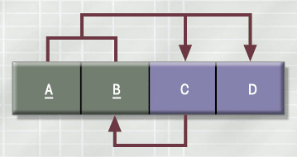
A Table That Is In 3NF But Not In BCNF

Slide 6
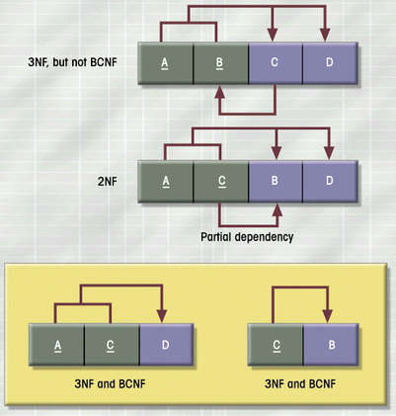
The Decomposition of a Table Structure to Meet BCNF Requirements

Slide 7
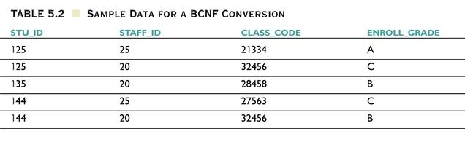
Sample Data for a BCNF Conversion

Slide 8
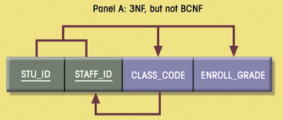
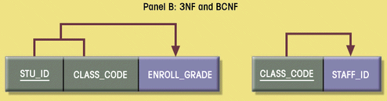
Decomposition into BCNF

Slide 9
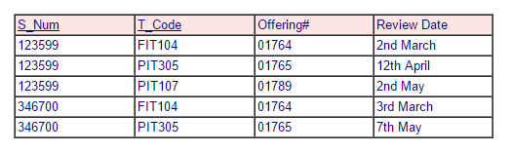
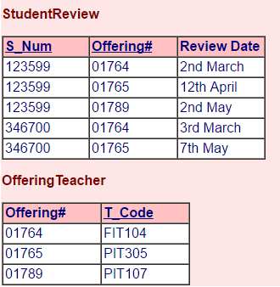
BCNF (Activity)
Convert the following table into BCNF
Notes:
Solution hidden behind image

Slide 10
BCNF Definition
BCNF Definition
A table is in BCNF if every determinant in that table is a candidate key. If a table contains only one candidate key, 3NF and BCNF are equivalent.

Slide 11
Normalization
Normalization will help us identify correct and appropriate TABLES.
Until Now we have 4 tables
PROJECT (PROJ_NUM, PROJ_NAME)
ASSIGN (PROJ_NUM, EMP_NUM, HOURS)
EMPLOYEE (EMP_NUM, EMP_NAME, JOB_CLASS)
JOB (JOB_CLASS, CHG_HOUR)

Slide 12
Multivalued Dependencies
A multivalued dependency occurs when a determinant is matched with a particular set of values:
Employee → Degree
Employee → Sibling
PartKit → Part
The determinant of a multivalued dependency can never be a primary key.

Slide 13
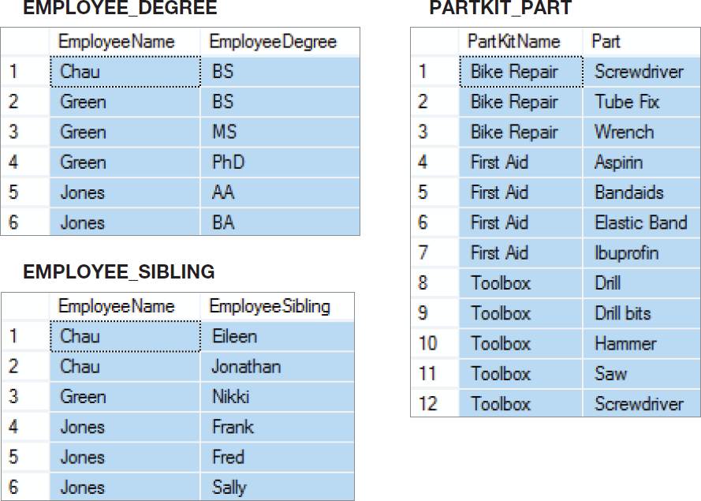
Multivalued Dependencies

Slide 14
Two Multivalued Dependencies
EMPLOYEE_DEGREE_SIBLING
 | EmployeeName | EmployeeDegree | EmployeeSibling
1 | Chau | BS | Eileen
2 | Chau | BS | Jonathan
3 | Green | BS | Nikki
4 | Green | MS | Nikki
5 | Green | PhD | Nikki
6 | Jones | AA | Frank
7 | Jones | AA | Fred
8 | Jones | AA | Sally
9 | Jones | BA | Frank
10 | Jones | BA | Fred
11 | Jones | BA | Sally

Slide 15
Eliminating Anomalies from Multivalued Dependencies
Multivalued dependencies are not a problem if they are in a separate relation, so:
Always put multivalued dependencies into their own relation.
This is known as Fourth Normal Form (4NF).

Slide 16
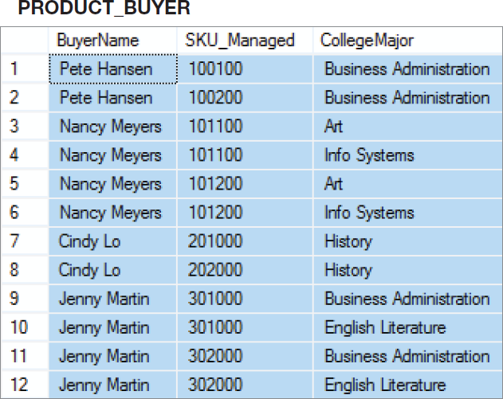
That Very Strange Table Again
Now we understand why this is a very strange table.
It has multivalued dependencies!
Notes:
To understand why this is an odd table, suppose that Nancy Meyers is assigned a new SKU, say 101300. What addition should we make to this table?
Clearly, we need to add a row for the new SKU, but if we add just one row, say the row ('Nancy Meyers', 101300, 'Art'), it will appear that she manages product 101300 as an Art major, but not as an Info Systems major.
To avoid such an illogical state, we need to add two rows:
('Nancy Meyers', 101300, 'Art') and ('Nancy Meyers', 101300, 'Info Systems').
Now, that is strange!

Slide 17
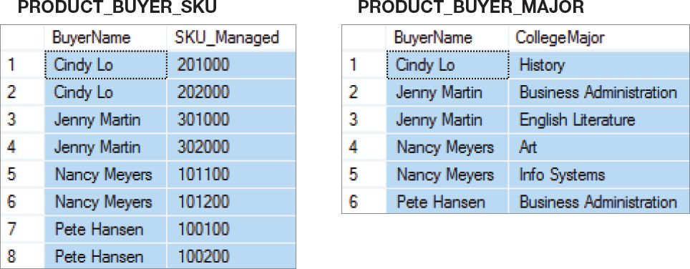
4NF
Use 4NF to resolve the multivalued dependencies!

Slide 18
Denormalization
Normalization is one of many database design goals.
However, normalized tables result in:
additional processing
loss of system speed
When normalization purity is difficult to sustain due to conflict in:
design efficiency
information requirements
processing speed
Denormalize by
use of lower normal form
use of controlled data redundancies

Slide 19
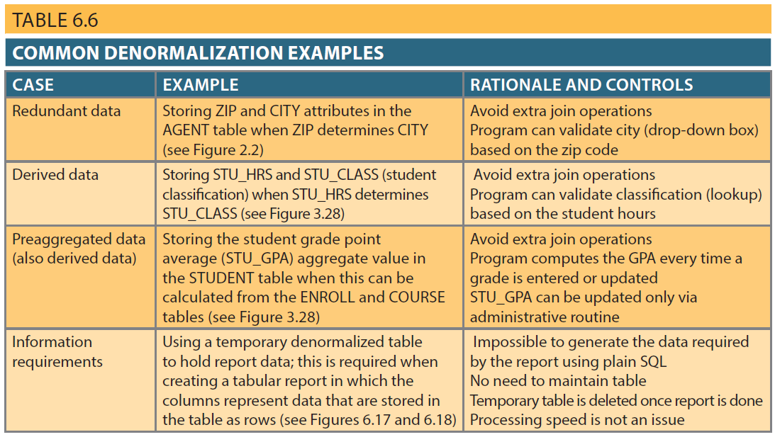
Table 6.6 – Common Denormalization Examples

Slide 20
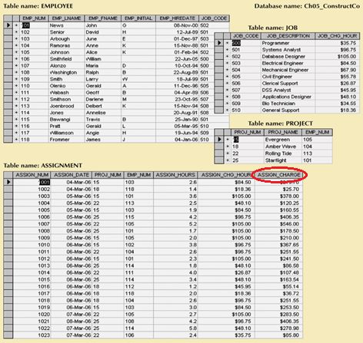
Denormalization

Slide 21
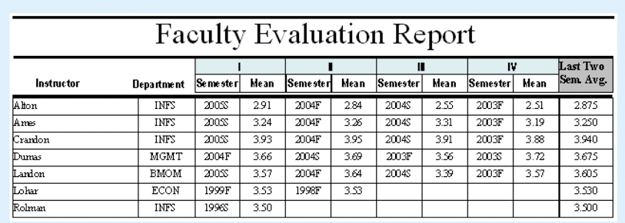
Denormalization
In order to generate the report below, a temporary denormalized table is used since the last four semesters of each faculty member could be different due to sabbatical, leave, start date, etc

Slide 22
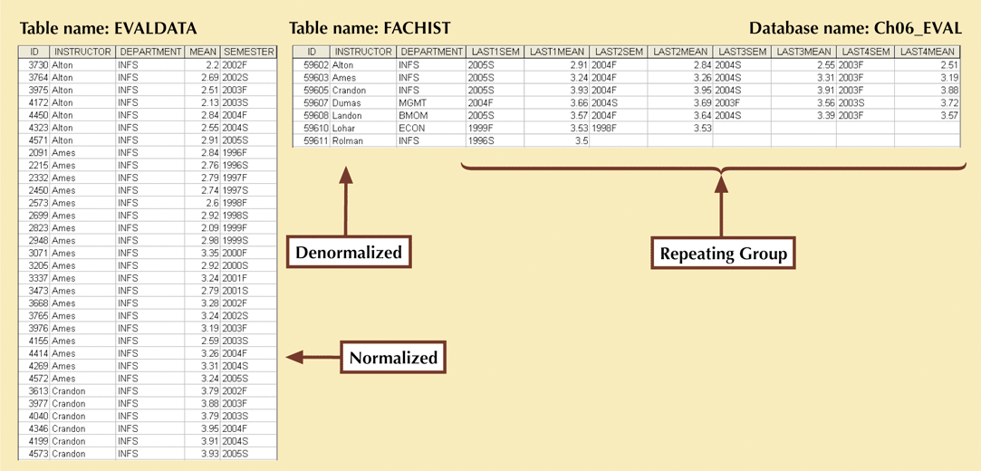
Denormalization
EVALDATA is the master data table which is normalized
FACHIST is created via a series of queries in order to produce the desired report

Slide 23
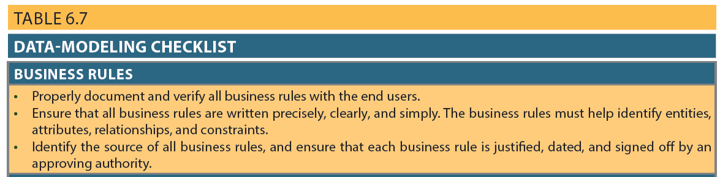
Table 6.7 - Data-Modeling Checklist

Slide 24
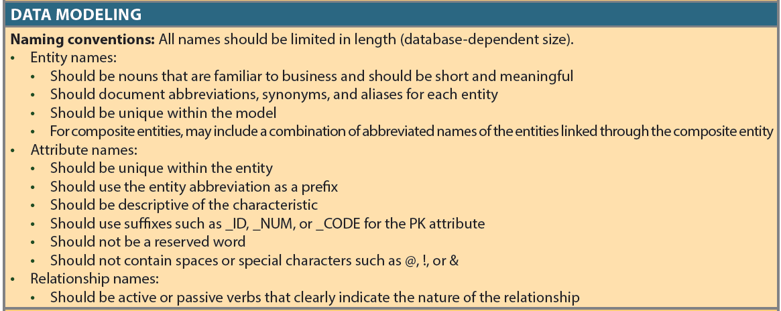
Table 6.7 - Data-Modeling Checklist (cont’d.)

Slide 25
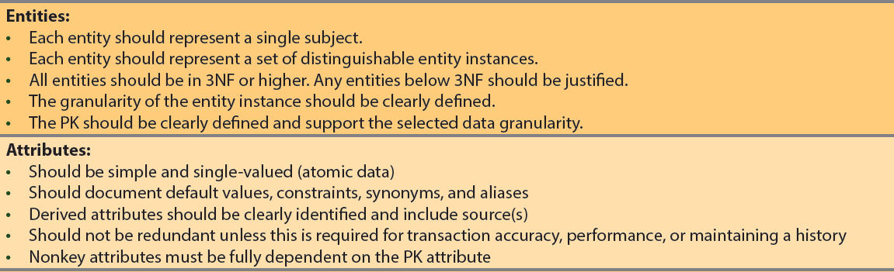
Table 6.7 - Data-Modeling Checklist (cont’d.)

Slide 26
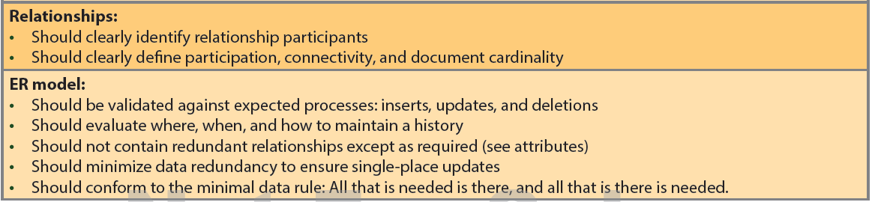
Table 6.7 - Data-Modeling Checklist (cont’d.)

Slide 27


Normalization Process
Normalization Process
Relation/Table Format
1)Repeat Group
2)PK is not defined
(1 Table)
Have repeating group -PK not defined
UNF
(1 or 2 Tables)
1NF
1)Remove Repeat Group
2)Defined PK → composite PK consist of attributes
No repeating group -PK defined -Test partial dependency
Test for partial dependency
If (exist)
(a → …… TD) 1
(b → ….. TD) 2
(a b→ …. TD) 3
2NF
(2 or 3 Tables)
(more then 1 table)
No repeating group -PK defined -No partial dependency -Test transitive dependency
Test for transitive dependency
If (exist)

Slide 28
Normalization Process
Normalization Process
Relation/Table Format
(a, b → x, y)
(a → c, d) [TD]
(b → z)
(c → d)
(3 or 4 Tables)
No repeating group -PK defined -No partial dependency -No transitive dependency
BCNF
3NF
4NF
Identify multiple multi-valued attributes
Create separate tables containing each of multi-valued attributes
COURSE | CRS_TEXT
S511 | DB design
S511 | Inside Access 2007
COURSE | CRS_TEXT | CRS_INSTRUCTOR
S511 | DB design | Jones
S511 | DB design | Smith
S511 | Inside Access 2007 | Jones
S511 | Inside Access 2007 | Smith
COURSE | CRS_INSTRUCTOR
S511 | Jones
S511 | Smith

